Slide 1
Chapter 5 Trees

Slide 2
Outline
Traversing a binary tree
Threaded binary tree
Binary search tree insert and search

Slide 3
Traversing a binary tree
用list的方式實作binary tree的四種走訪方式
實作步驟
建立樹的node結構(struct)
建立一棵binary search tree: insertNode()
拜訪樹的主要function
前序走訪: preOrder()
中序走訪: inOrder()
後序走訪: postOrder()
階層走訪: levelOrder()

Slide 4
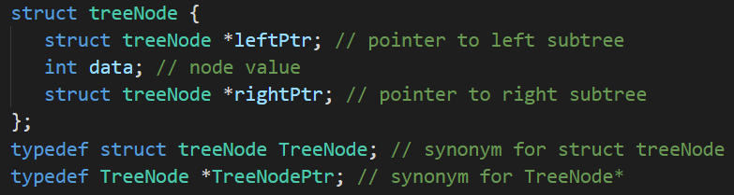
Traversing a binary tree
建立樹的node結構(struct)

Slide 5
Traversing a binary tree
建立一棵binary search tree
40
40, 17, 95, 22, 65, 70, 98
17
95
22
65
98
70

Slide 6
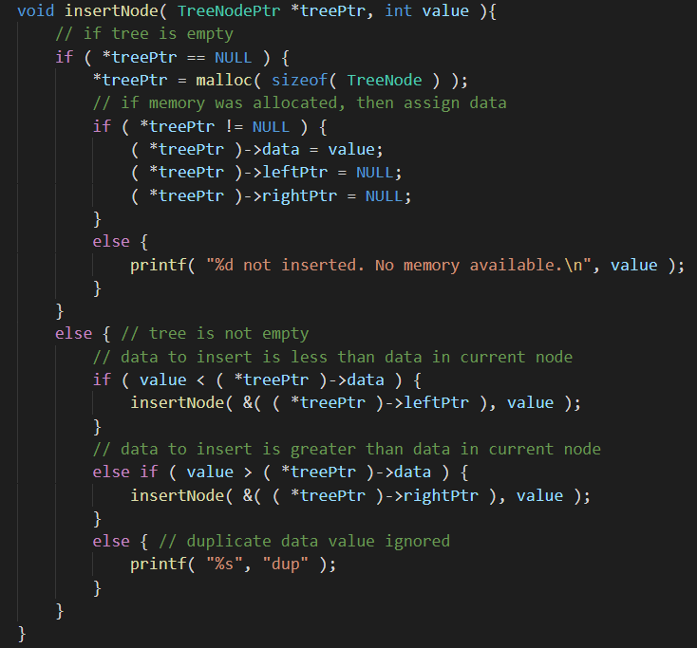
Traversing a binary tree
插入: insertNode()

Slide 7
Traversing a binary tree
插入: insertNode()

Slide 8
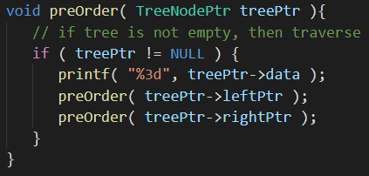
Traversing a binary tree
前序走訪(preorder):
40
17
22
95
65
70
98
40
17
95
22
65
98
70

Slide 9
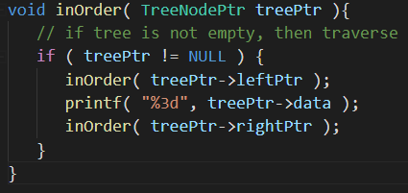
Traversing a binary tree
中序走訪(inorder):
17
22
40
65
70
95
98
40
17
95
22
65
98
70

Slide 10
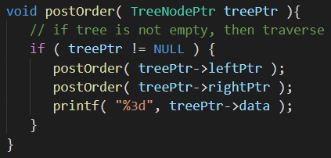
Traversing a binary tree
後序走訪(postorder):
22
17
70
65
98
95
40
40
17
95
22
65
98
70

Slide 11
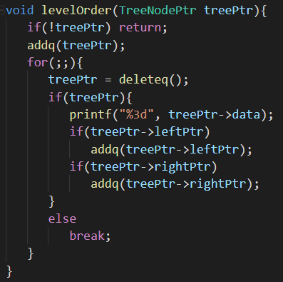
Traversing a binary tree
queue
40
17
95
22
65
98
70
階層走訪(level-order):
40
17
95
22
65
98
70
40
17
95
22
65
98
70

Slide 12
Threaded binary tree
用list的方式實作threaded binary tree的插入
實作步驟
建立樹的node結構(struct)
建立一棵threaded binary tree
主要function
插入: insertRight ()

Slide 13
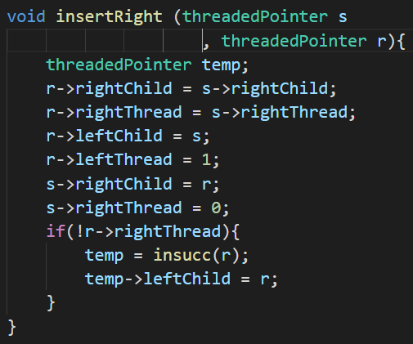
Threaded binary tree
insertRight()
s
r

Slide 14
Binary search tree insert and search
用list的方式實作binary search tree的插入和搜尋
實作步驟
建立樹的node結構(struct)
建立一棵binary search tree
主要function
插入: insertNode()
搜尋: searchNode()

Slide 15
Binary search tree insert and search
建立一棵binary search tree
40
40, 17, 95, 22, 65, 70, 98
17
95
22
65
98
70

Slide 16
Binary search tree insert and search
插入 20
40
20 < 40
17
95
20 > 17
22
65
98
20 < 22
20
70

Slide 17
Binary search tree insert and search
搜尋 70
40
70 > 40
17
95
70 < 95
22
65
98
70 > 65
20
70

Slide 18
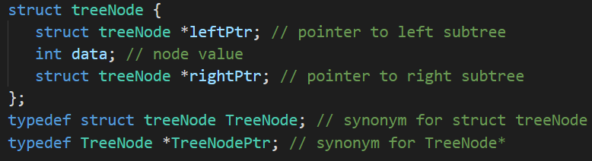
Binary search tree insert and search
建立樹的node結構(struct)

Slide 19
Binary search tree insert and search
插入: insertNode()

Slide 20
Binary search tree insert and search
插入: insertNode()

Slide 21
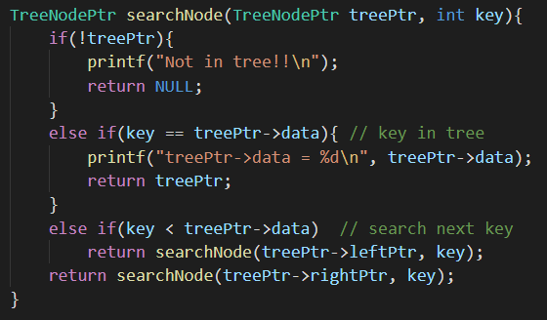
Binary search tree insert and search
搜尋: searchNode()

